Slide 1
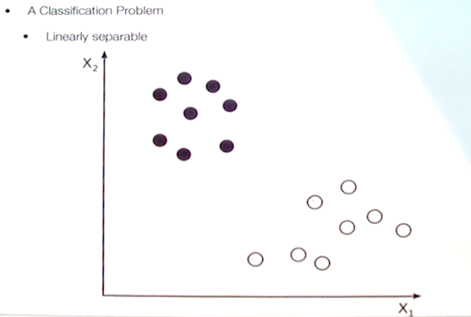
Support Vector Machine
A classification Problem
Linearly Separable.
Two independent variables x1, x2 and one dependent variable (White and Black)

Slide 2
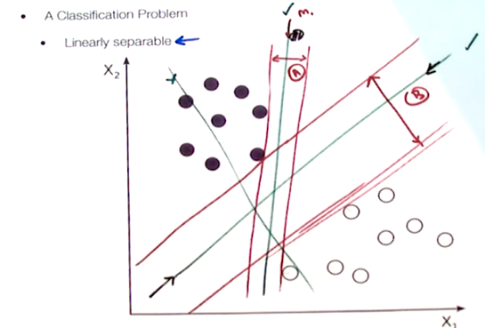
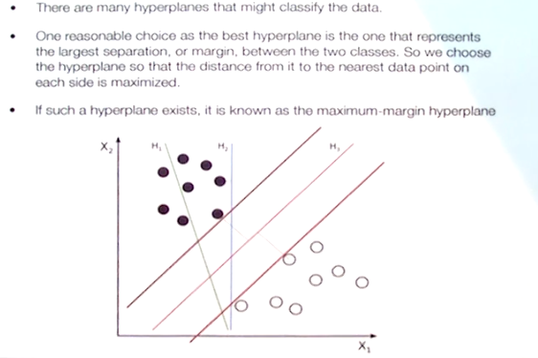
It calculates the margin of the hyper planes and find out which hyper place is the best. Here Margin A is lesser than Margin B.
B is called as maximum margin hyperplane.

Slide 3
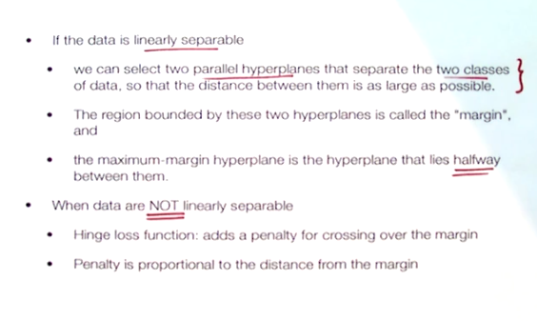

Slide 4
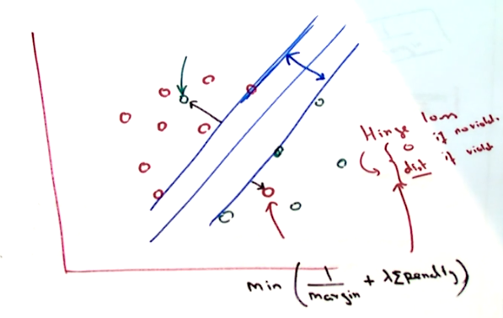
Data which is not linearly separable.
In this case we are increasing the margin that is equal to decreasing 1/margin.
Max(margin)=Min(1/margin)
Sum of penalties added i.e. called Hinge Loss
It is 0, in case of non violation and it is proportionate to dist in case of violation.
This soft margin hyperplace helps
To classify the non-linearly
separable
Data points.

Slide 5
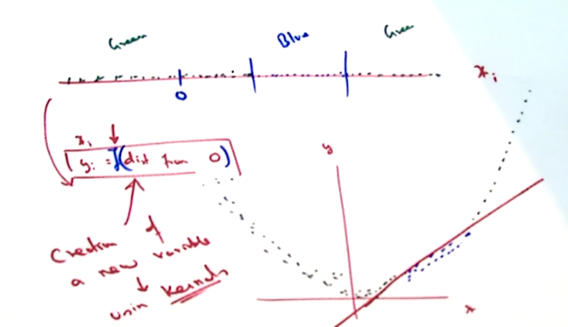
When all the data points are lies in one line which can not separable then we create another variable which is a non-linear function of x that is called karnel.

Slide 6
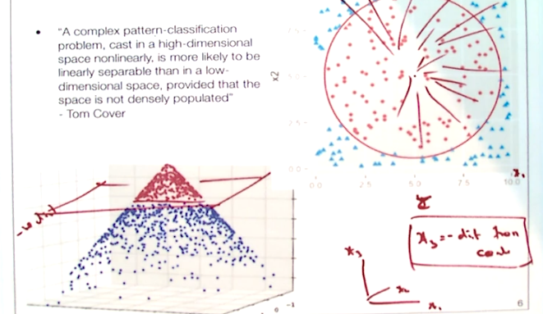
SVM Karnel
In this problem, betwn red circles and blue traingles we can’t draw a separable plane easily.
But creating another variable x3 which can be the –ve distance betwn the data points called a karnel we can easily separate out.

